Slide 1
Cyber UEBA: catching what single-user rules miss
Lead: Ravindra Shukla
Legacy scores one user against a fixed line and misses all four stealth attacks. V-Intelligence reads the same logs as behavioral entities — and catches every one.
LEGACY
BEHAVIORAL TWIN
RESULT
one user vs a threshold
same logs, in context
caught, with evidence
Single-user history only
Cohort-relative deviation
What a user HAS done
plus where they’re HEADING
Fixed alert thresholds
>
Self-drift over time
>
0 of 4 attacks flagged
Known-bad profile match
Evidence-backed, explainable
4 of 4 caught · 0 false positives
Why it matters
Point-anomaly tools saw normal employees; the behavioral twin named each attack by the behavior that gave it away.
CONFIDENTIAL | 22nd Century Technologies | EDM Vector Intelligence — Cyber UEBA
1

Slide 2
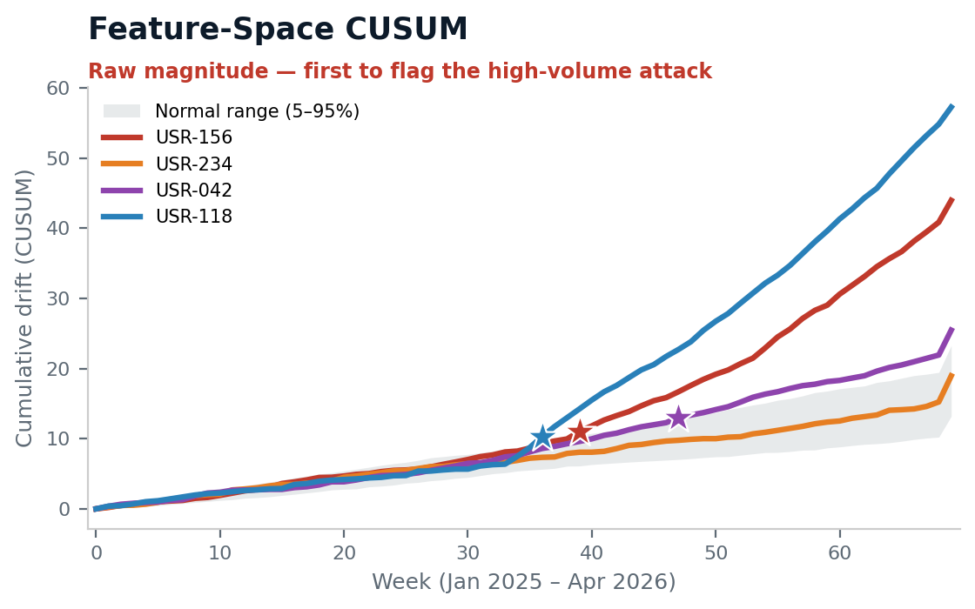
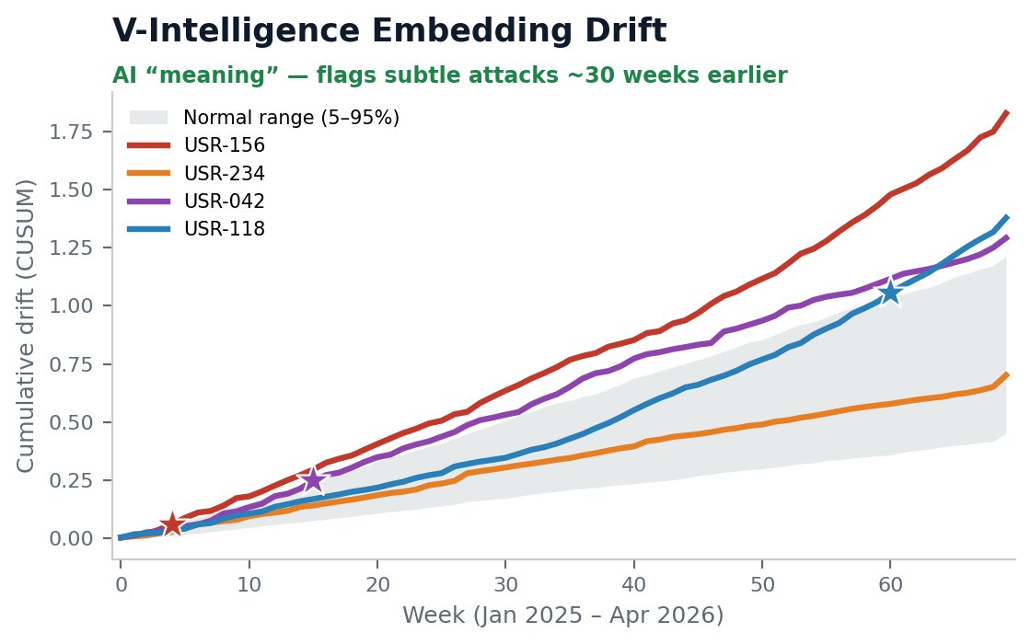
Signal separation: two lenses, different attacks caught first
Lead: Ravindra Shukla
Over the same 70-week campaign, the raw-numbers lens flags the noisy volume attack earliest; the AI “meaning” lens flags the subtle insider & stealth-hacker ~30 weeks sooner. Neither catches the slow APT alone.
First sustained detection (★): 156 → feature wk 39 / AI wk 4 · 042 → wk 47 / wk 15 · 118 → wk 36 / wk 60 · 234 → not flagged by drift alone
Each lens has a blind spot — so V-Intelligence runs both and fuses them with the cohort and known-bad fronts.
CONFIDENTIAL | 22nd Century Technologies | EDM Vector Intelligence — Cyber UEBA
2

Slide 3
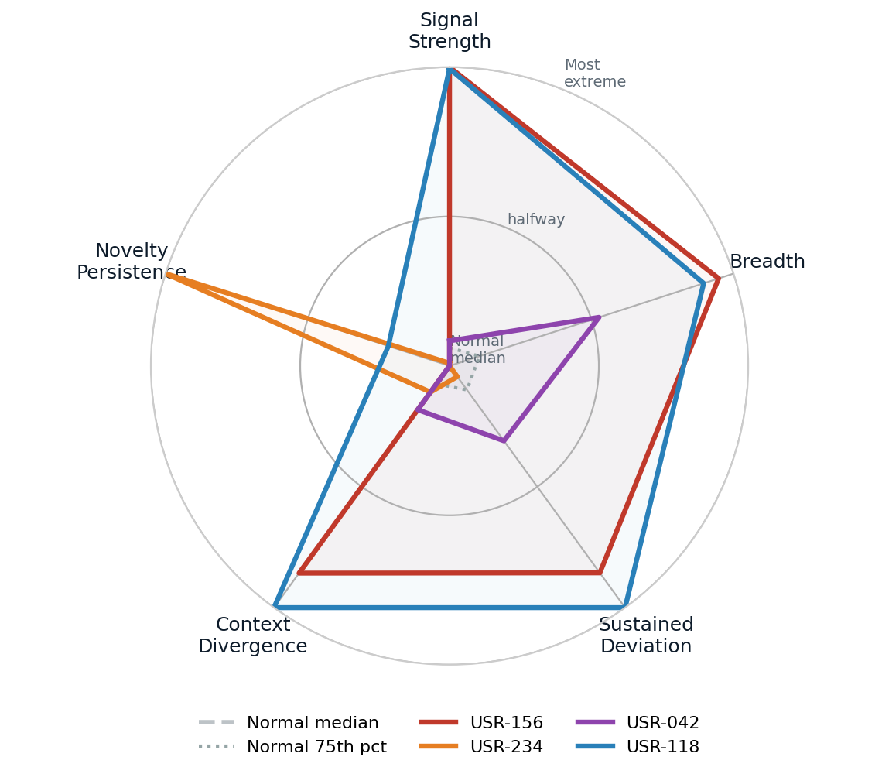
No normal user is extreme on every front at once
Lead: Ravindra Shukla
Each attacker pushes past the normal cluster on a different phase — that multi-phase extremity is the fingerprint a single threshold can’t see.
Grey = normal users (median & 75th percentile): a tight cluster near the center.
The five phases, in plain terms:
• Signal Strength — how far behavior departs from peers
• Breadth — how many behaviors shifted at once
• Sustained Deviation — how long the shift persisted
• Context Divergence — how unlike its role-group it became
• Novelty Persistence — new connections (e.g., C2) that keep recurring
USR-156 dominates Signal Strength & Breadth; USR-234 spikes on Novelty Persistence (its C2 beacon); USR-118 stretches Context Divergence. No normal user reaches these extremes on multiple phases at once.
Synthetic / representative demo data — to be revalidated on DLA data before production claims.
CONFIDENTIAL | 22nd Century Technologies | EDM Vector Intelligence — Cyber UEBA
3

Slide 4
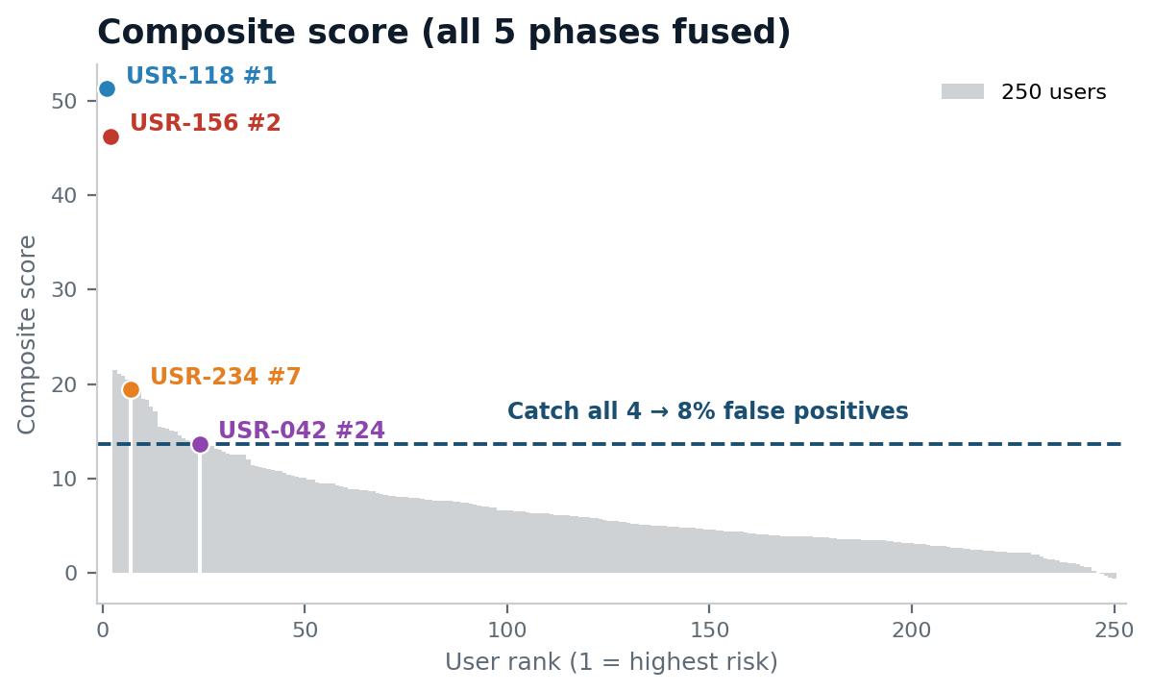
Fused into one score: 4 of 4, at 8% false positives
Lead: Ravindra Shukla
The five phases combine into a single composite — every attacker rises above the line that catches all four, surfacing the two stealth movers legacy scored as normal.
0 → 4 of 4
stealth attacks caught that legacy scored as normal
• 39 legacy false alarms → 0 on the threat-profile match
• Subtle attacks flagged up to ~30 weeks earlier
• Every alert names the behavior that fired — auditable
Synthetic / representative demo data — to be revalidated on DLA data before production claims.
CONFIDENTIAL | 22nd Century Technologies | EDM Vector Intelligence — Cyber UEBA
4

